Slide 1
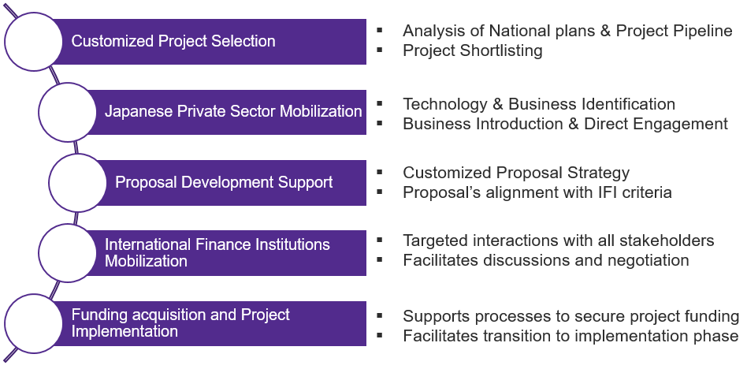
ConneQt - Mobilizing Finance For Your Projects
Your Gateway to the Japanese Private sector and International Finance Institutions (IFIs)
Summary
Process
【Current situation】
Projects in Africa face funding challenges due to limited access to finance.
The Japanese private sector has little exposure and knowledge of the business potential of these projects.
【Challenges】
Accessing finance from IFIs (MDBs, UN agencies, and other multilateral funds) is complex without the right expertise.
The lack of understanding of financial instruments from IFIs by Japanese private sector further hinders their engagement and investment opportunities
【QUNIE’s approach】
We provide a unified and practical solution to bridge the gap, trigger interest, and unlock finance for your projects thanks to our network and expertise
1
2
3
4
5
Fees
Entry-Level Services are free of cost for any African Embassy or Investment Promotion Agency

Slide 2
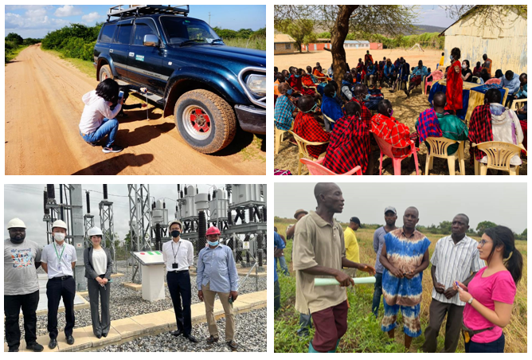
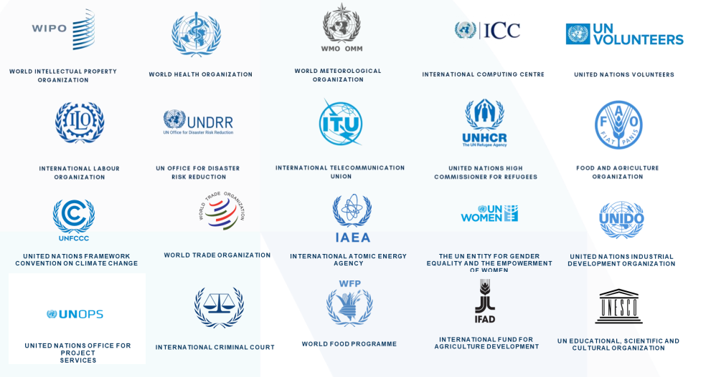
ConneQt - with NTT Data EMEAL
Your Gateway to the Japanese Private sector and International Finance Institutions (IFIs)
Qunie’s Capabilities
Collaboration with NTT Data EMEAL
Numerous projects in Africa since 2019
A specific expertise for projects and business opportunities promoted by Multilateral Development Banks and UN agencies.
NTT Data EMEAL has a team focusing on International Organizations and it is a leading service provider to Multilateral Development Banks and UN agencies
With staff located in all major IFIs headquarters (New York, Geneva, Washington etc.), we can support your projects directly with managers and procurement departments.
+300 people working with IFIs
25 LTAs
with agencies
Major headquarters cities directly covered

